Slide 1
UE20CS344 – Network Analysis and Mining
Course Project
Project Title :
Predicting Network Connectivity in Traffic Networks: A Comparative Analysis of Link Prediction Algorithms Using Sumo Simulation
Team member 1 SRN and name: Shubham S PES1UG20CS420
Team member 2 SRN and name: Shuchith B U PES1UG20CS421
Team member 3 SRN and name: Siddarth M P PES1UG20CS423
Team member 4 SRN and name: Amogh N Rao PES1UG20CS625

Slide 2
Topic
Using Sumo simulation, we generate a graph from open street map traffic scenario data and compute simulation metrics like waiting time and duration. We improve simulation metrics, by implementing certain actions based on the generated graph data.
Then, we apply multiple link prediction algorithms, including common neighbors, Jaccard coefficient, Adamic/Adar index, and Preferential Attachment to the generated graph and compare their performance in predicting network connectivity.
This study has significant implications for traffic network design and optimization, and the development of intelligent transportation systems, helping to improve traffic flow and reduce congestion in real-world traffic scenarios.

Slide 3
Uniqueness
The use of Sumo simulation to generate a graph and compute simulation metrics provides a realistic and accurate representation of real-world traffic scenarios. Additionally, the study uses dynamic graphs to improve simulation metrics and simulate scenarios where links are lost in the network.
And in the context of Traffic Networks, The comparison of multiple link prediction algorithms to predict network connectivity is another unique aspect of this study, as it provides valuable insights into the most effective methods for predicting linkages between connected vehicles in a traffic network.
We hope that the findings of this study have significant implications for the design and optimization of traffic networks and the development of intelligent transportation systems, which can improve traffic flow and reduce congestion in real-world traffic scenarios.

Slide 4
Dataset
This study does not utilize a pre-existing dataset for traffic network analysis. This is because there is no standardized dataset for traffic network analysis that can be used across different traffic scenarios. Additionally, the study uses a simulation approach to generate a traffic network scenario that is specific to the research question being investigated.
Instead of relying on pre-existing datasets, the study generates a graph from the Sumo simulation data to perform link prediction analysis. This approach allows the study to compare the performance of different link prediction algorithms using the same traffic network scenario, ensuring that the results are comparable and reliable.

Slide 5
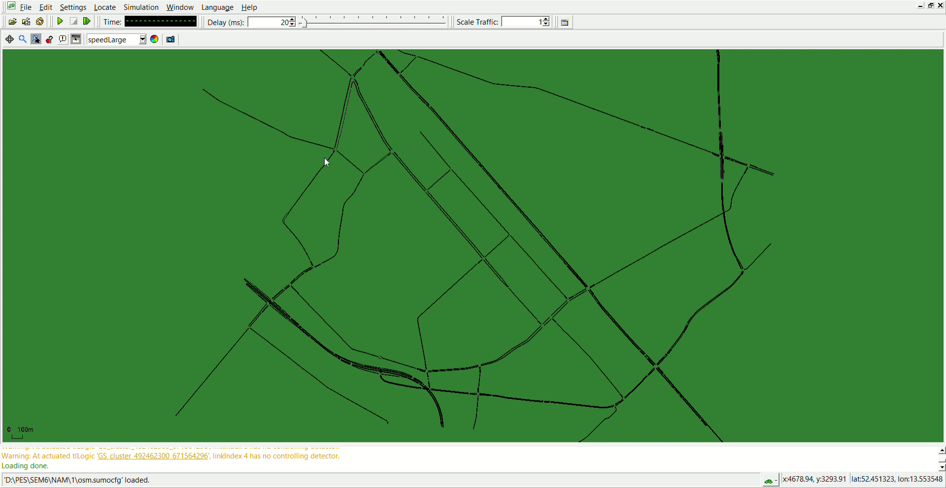
SUMO
T.

Slide 6
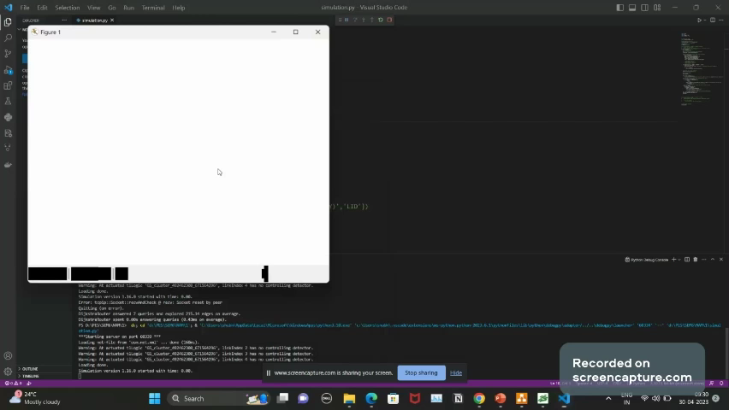
Graph Generated at each time step

Slide 7
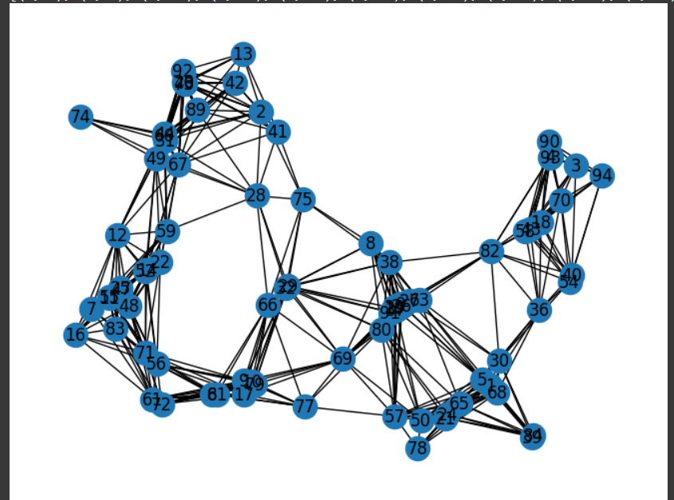
Final Graph generated

Slide 8
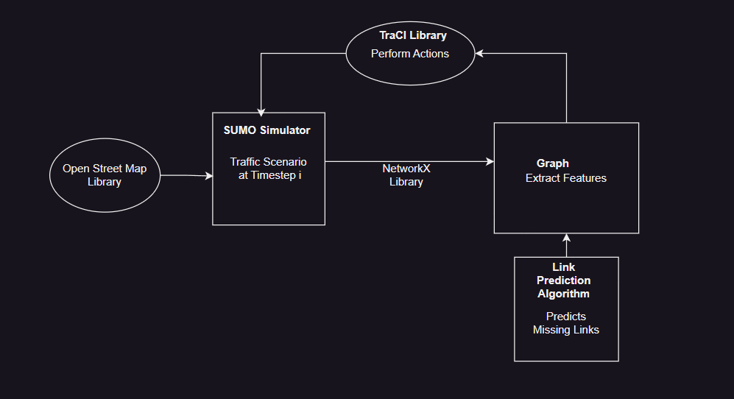
Overall design

Slide 9
Final results so far
For comparing the link prediction algorithms, the study uses accuracy and ROC curve statistics, These metrics are useful for determining the accuracy of the algorithms in predicting network connectivity based on the graph data.
However, the study also recognizes that accuracy alone may not be enough to evaluate the usefulness of the algorithms for real-world traffic scenarios. Therefore, the study uses waiting time and duration from the simulation tool as primary metrics to evaluate the performance of the link prediction algorithms in the context of traffic flow and congestion. These metrics are important indicators of the efficiency of the traffic network and directly influence the user experience for drivers and commuters.

Slide 10
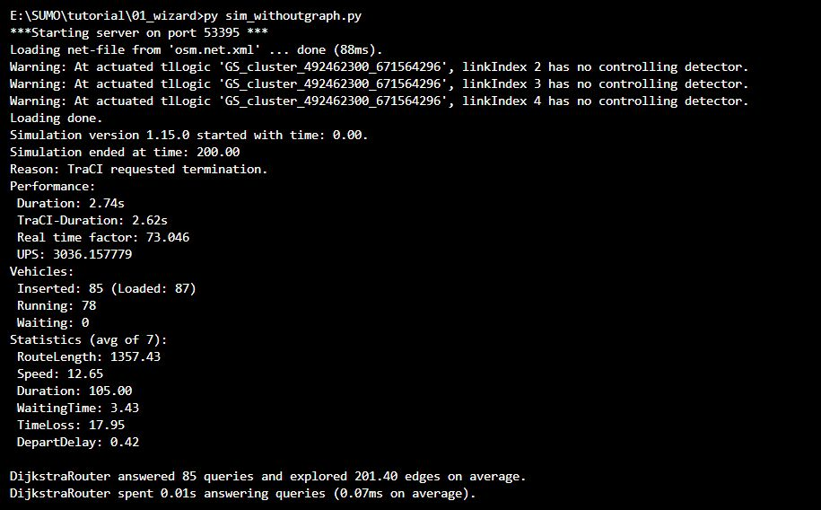
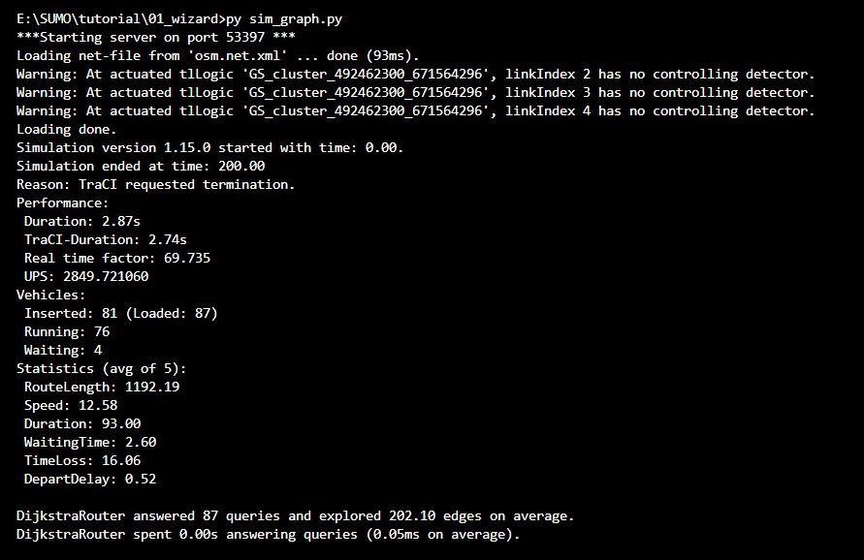












Simulation Results
Simulation Without Actions
Simualation With actions using Graph
An Improvement on the Simulation Metrics can be seen by using Graph to perform actions

Slide 11
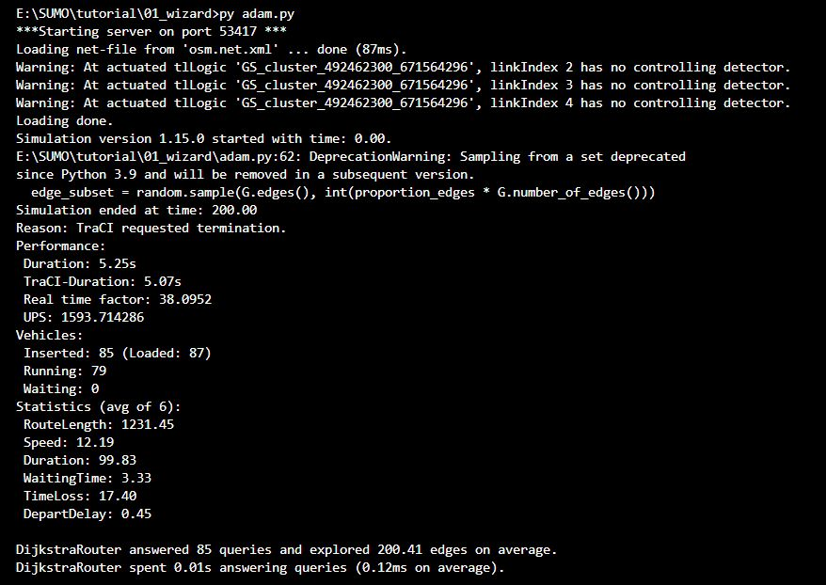
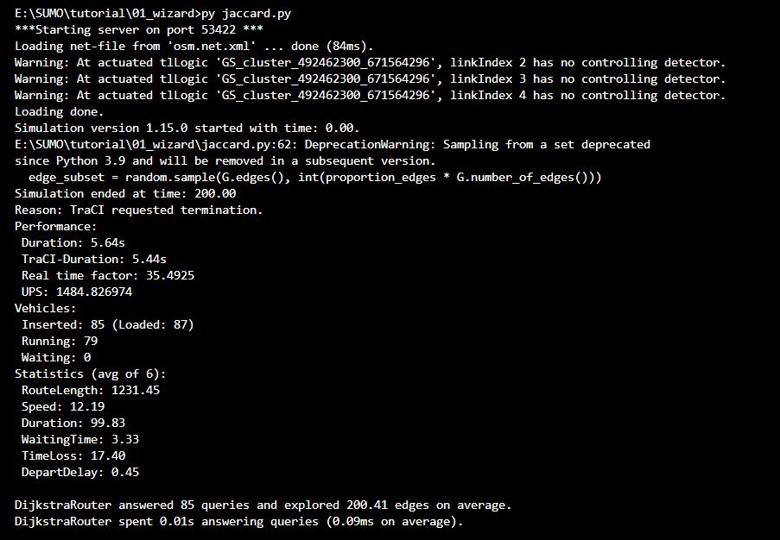










Applying Edge Prediction Algorithms to simulation
Adamic Adar
Jaccard
Both Adamic Adar and Jaccard perform similarly but Admaic Adar is a bit faster

Slide 12
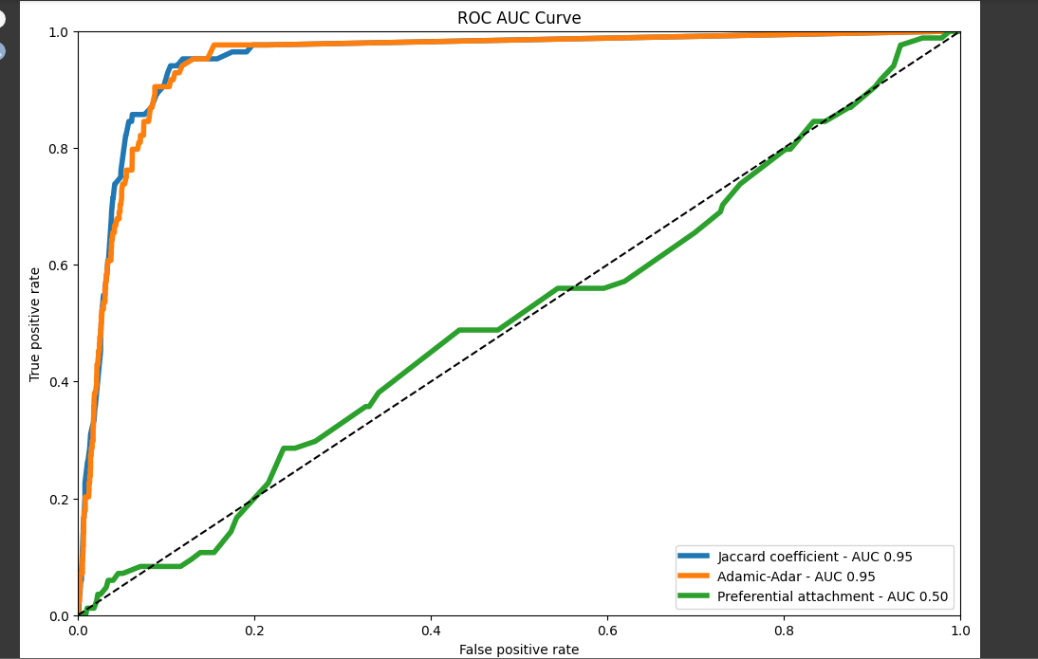
Comparing Edge Prediction Algorithms

Slide 13
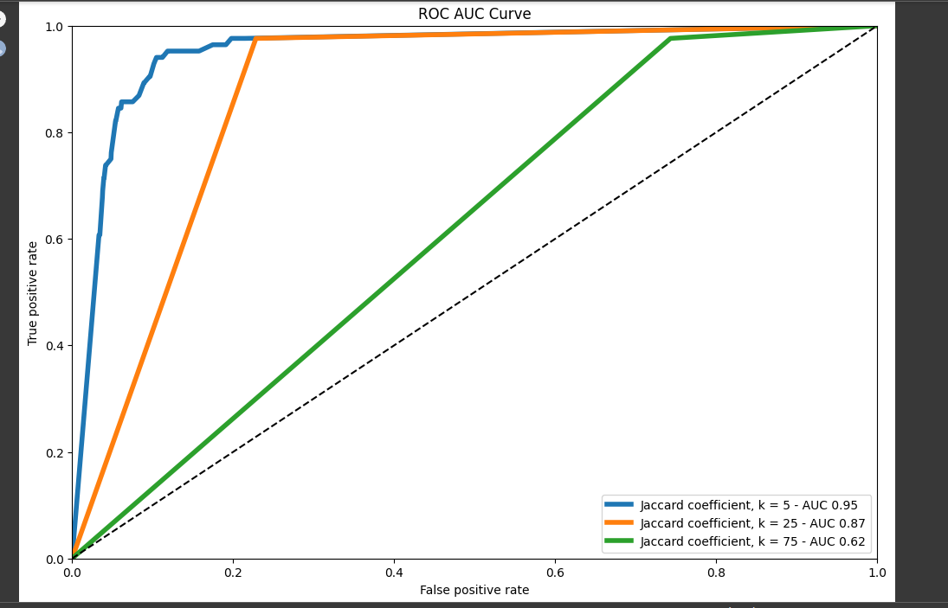
Top K approach

Slide 14
Done vs Remaining to be done ?
No | Description | Done or To be done
1 | Generated a graph from open street map traffic scenario data using Sumo simulation | Done
2 | Implemented certain actions based on the generated graph data to improve simulation metrics, such as Waiting Time | Done
3 | Applied multiple link prediction algorithms, including common neighbors, Jaccard coefficient, Adamic/Adar index,and Preferential Attachment, to the generated graph | Done
4 | Compared the performance of these link prediction algorithms in predicting network connectivity | Done
5 | Further explore optimizing each algorithm for traffic network design and optimization. | To be done
6 | Generate Better Action Space using Reinforcement Learing Algorithm | To be done

Slide 15
Quantity and quality of work
no | Code functionality | % Complete | Runs without problem (Y/N) | If there are minor issues, indicate
1 | Generate a graph from SUMO simulation and Increasing Speed if edges are less to a particular vehicle to reduce waiting time | 100 | Y
2 | Link prediction algorithms,Node2Vec model | 100 | Y
3 | Common neighbors Approach | 100 | Y
4 | Jaccard coefficient | 100 | Y
5 | Adamic-Adar similarity Approach | 100 | Y
6 | Preferential attachment measure | 100 | Y
7 | Comparing SUMO statistics, using all the above models | 100 | Y

Slide 16
Top few learning
Serial No | Top learning in this project
1 | Sumo simulation can be used to generate a graph from open street map traffic scenario data and compute simulation metrics like waiting time and duration.
2 | Implementation of certain actions based on the generated graph data can improve simulation metrics, such as Waiting Time
3 | Multiple link prediction algorithms, including common neighbors, Jaccard coefficient, Adamic/Adar index,and Preferential Attachment, can be applied to the generated graph to predict network connectivity in case of link failures.
4 | The performance of these algorithms were compared to identify the most effective ones for predicting network connectivity in traffic networks.

Slide 17
Top unresolved challenges
Serial No | Brief description of unresolved challenges | Type of challenge (scope/data/design/implementation / others)
1 | Run simulation for more Timesteps | Computational
2 | Updating actions to simulations using RL algorithm and setting appropriate RL reward function | Design
3 | Use more metrics such as Collision Rate from simulation | Data

